Slide 1
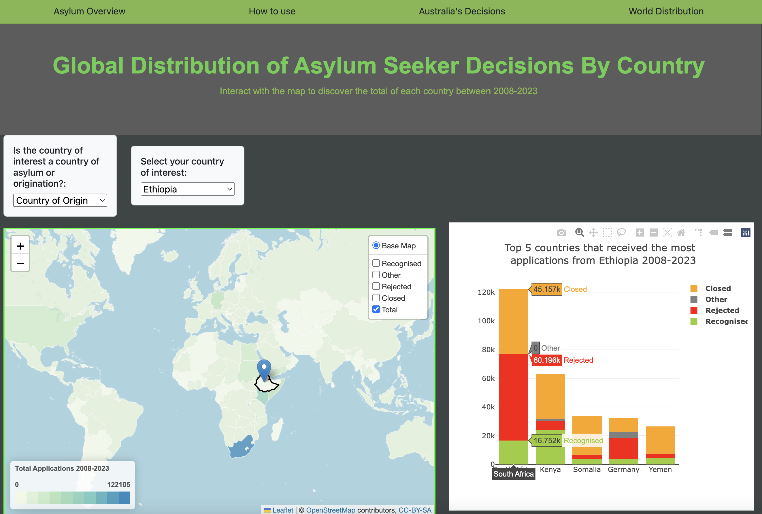
Project 3: Group 1
Brett Osborne
Caroline Jennings
Jolly Joseph
Ben Wruck

Slide 2
Introduction
A data visualisation project looking at asylum seekers from 2008 – 2023
Source – UNHCR, the UN Refugee agency. UNHCR is a global organisation dedicated to saving lives, protecting rights and building a better future for people forced to leave their homes because of conflict and persecution.
Source: API UNHCR's Refugee Data Finder
https://www.unhcr.org/refugee-statistics/insights/explainers/forcibly-displaced-api.html
This API alowed us to look at metadata; countries, regions and years.
As well as UNHCR datasets; asylum applications, asylum decisions, population data, demographics, footnotes and solutions

Slide 3
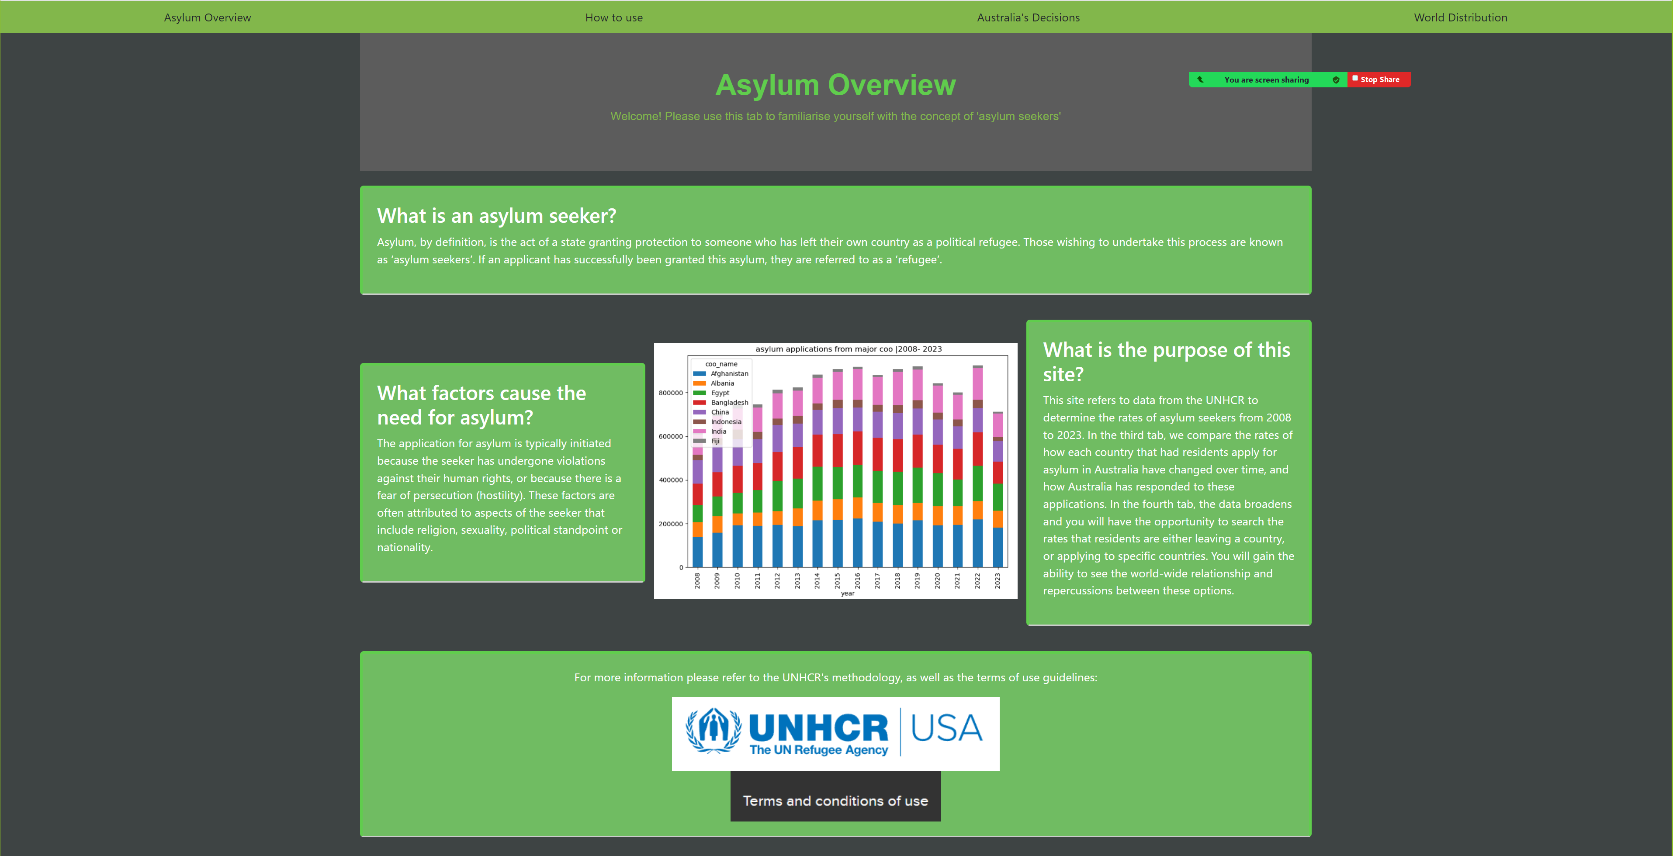
Asylum Overview​

Slide 4
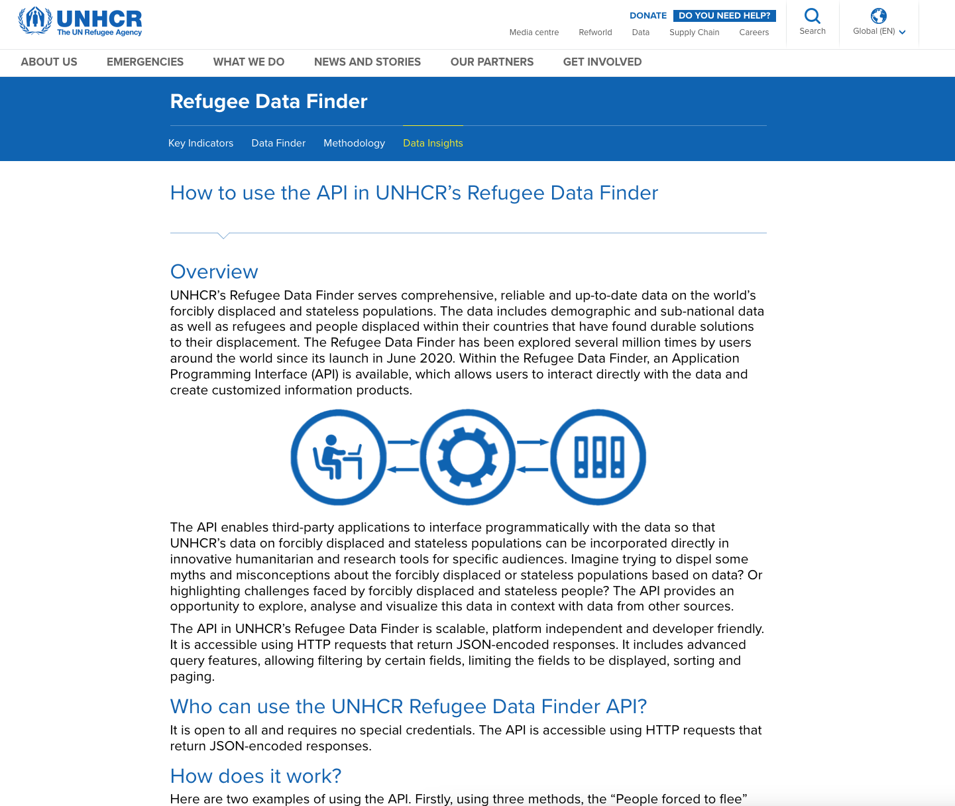
Data Source – UNHCHR Website and API
https://www.unhcr.org/refugee-statistics/insights/explainers/forcibly-displaced-api.html
A well documented website.
Datasets contain data with a break down over years and countries.
Many choices for sub-datasets e.g.
Asylum seeker applications
Asylum seeker decisions by governments or authorities
Population data
Demographics and Solutions

Slide 5
Ethical Consideration
UNHCR Ethics Office adheres to the UNHCR's Code Of Conduct
Ethics regarding Datasets
Privacy and Confidentiality
Informed Consent
Data Security
Bias and Representation
Data use and accountability
Benefits versus Harm
Cultural Sensitivity
Ethical Oversight and Compliance

Slide 6
Ethics continued....
The Expert Group on Refugee and IDP Statistics (EGRIS) was established in 2016 by
the UN Statistical Commission (UNSC). It is tasked with addressing these challenges
including the lack of consistent terminology and difficulties in comparing statistics
internationally. Key guidance produced by EGRIS so far includes:
International Recommendations on Refugee Statistics (IRRS, published in 2018) - an internationally accepted framework for statistics on refugee and refugee-related populations.
Refugee statistics compilers’ manual with operational instructions established in compliance with the IRRS.
International Recommendations on Internally Displaced Persons Statistics

Slide 7
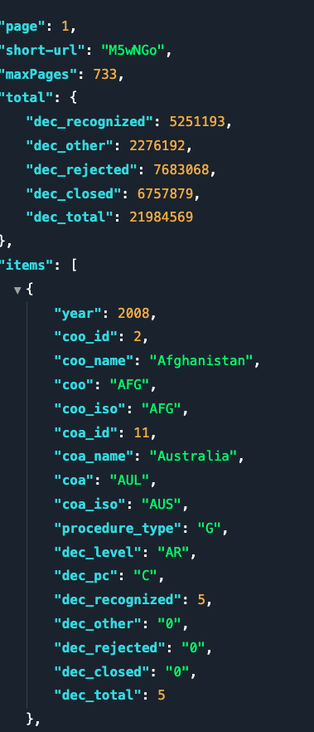
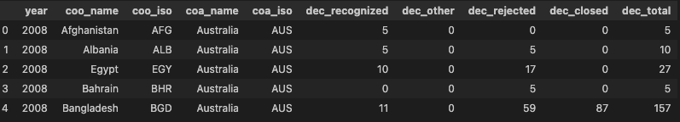

The Data and Storage
Made a choice to use the Decisions dataset:
Limit the dataset to years 2008-2023
Use all kinds sub-categories:
Procedure stages
Decision levels
Final dataset in project is trimmed down to:
Additional data source for country GeoJSON polygons
https://github.com/datasets/geo-countries sourced from Natural Earth
Used a NoSQL Mongodb to store and retrieve data

Slide 8



Tab 2: How to use and understand the site
The second tab <How to use> explains the terminology used within the visualisations, and how to navigate the map. The terms will be briefly covered here:
Coo/coa: country of origin/country of asylum
Recognised/Rejected/Closed/Other: All these refers to categories of responses between your chosen country of origin (coo) and Australia.
Line Graphs :These graphs show the numbers of all five categories of responses between your chosen country of origin (coo) and Australia. Each is totalled per year and can give you an absolute value if you hover over any given point
Pie Graphs: These graphs will give the breakdown of each decision over the entire timeframe of 2008-2023. The total is excluded from this graph, however, percentages have also been included
Maps: On the top left, you can toggle between the four outcomes. You can select the country from drop down. There is also unique legends for each outcome and pop up to notify the country name.

Slide 9
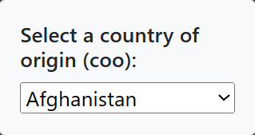
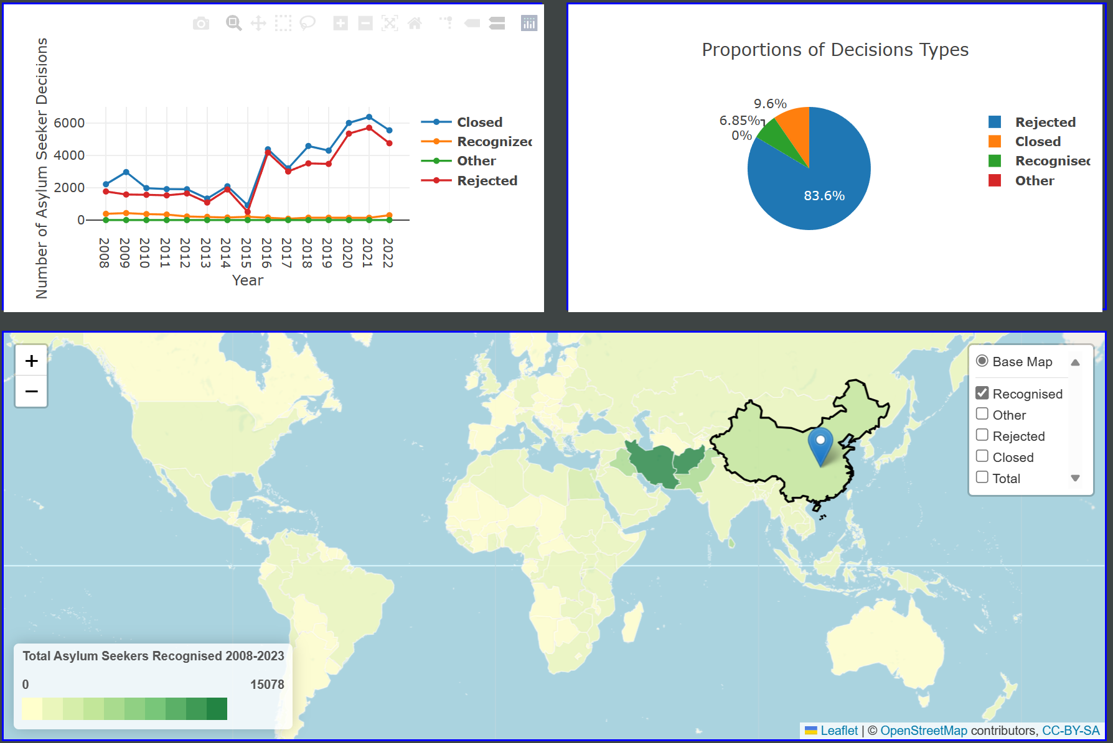
Tab 3: Visualisations for Australia
1.1: Example dropdown box
choice
Tab 3 uses data for any country that has had residents apply for asylum in Australia (Australia = coa)
The drop-down on the left indicates which country you would like to view (figure 1.1)
When selected, the graphs and map will update (Figure 1.2)
Left: Line graph outlining changes over time
Right: Pie graph outlining collective choices over all time
Bottom: Map outlining selected country and allowing for exploration
Note any key data in the comment section
1.2: Example of maps

Slide 10
Tab 4: World map
This feature was to consider the rates of asylum on a world scale. First, choose if you want to see a country's coo or coa movement, then follow through with which country you would like to view

Slide 11
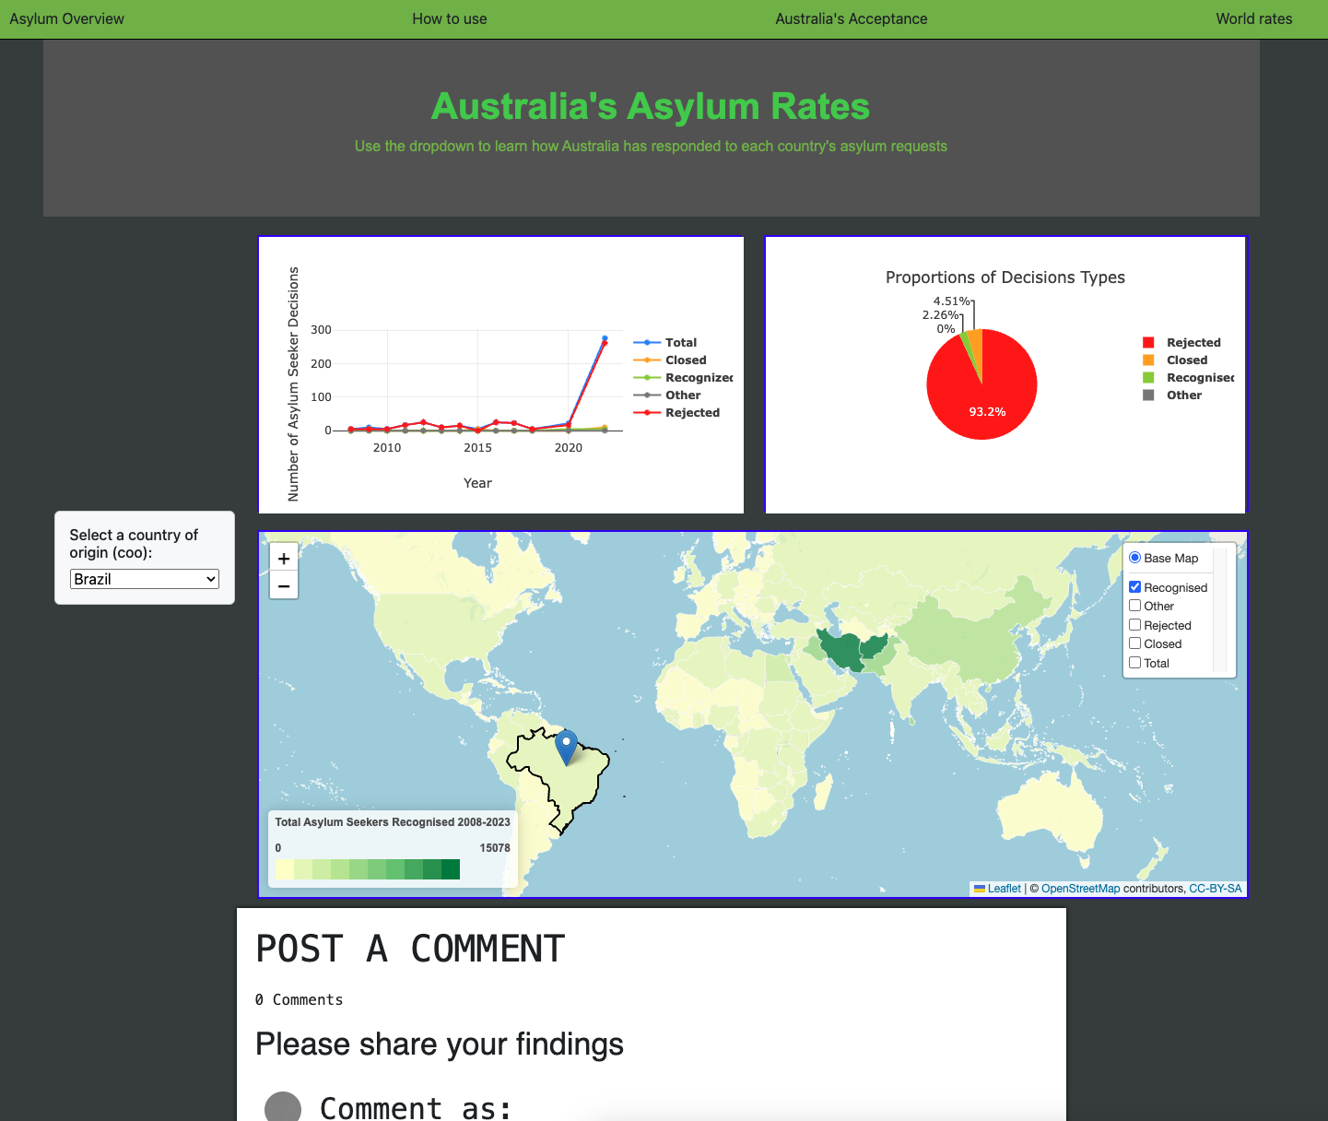
Summary
We were able to retrieve and store data from the UNHCR API
Users can clearly visualize and interact with a website to provide meaningful insights into decision making by governments and authorities for Asylum Seekers.
Limitations
Location mapping: Examples where states have multiple boundaries shown
Double dipping: There are additional categories of asylum seeker processing stages and we have summed these. E.g repeat/reopened applications, administrative review decisions
Future Work and Enhancements
Address 'Limitation: 1’
Create a live connection to the UNHRC API
Use the additional data categories
Add extra graphs to the Tab 4 graph over time
Complete functionality of comment section

Slide 12
References
https://www.unhcr.org/about-unhcr
https://api.unhcr.org/docs/refugee-statistics.html
https://stackoverflow.com/questions/43121679/how-to-append-option-into-select-combo-box-in-d3
https://blog.debugeverything.com/how-to-use-arrow-functions-with-javascript-filter/
https://masteringjs.io/tutorials/fundamentals/foreach-object
https://plotly.com/javascript/bubble-charts/
https://plotly.com/javascript/time-series/
https://www.youtube.com/watch?v=5L6h_MrNvsk
https://www.youtube.com/watch?v=drkpDLy92uA

